Slide 1
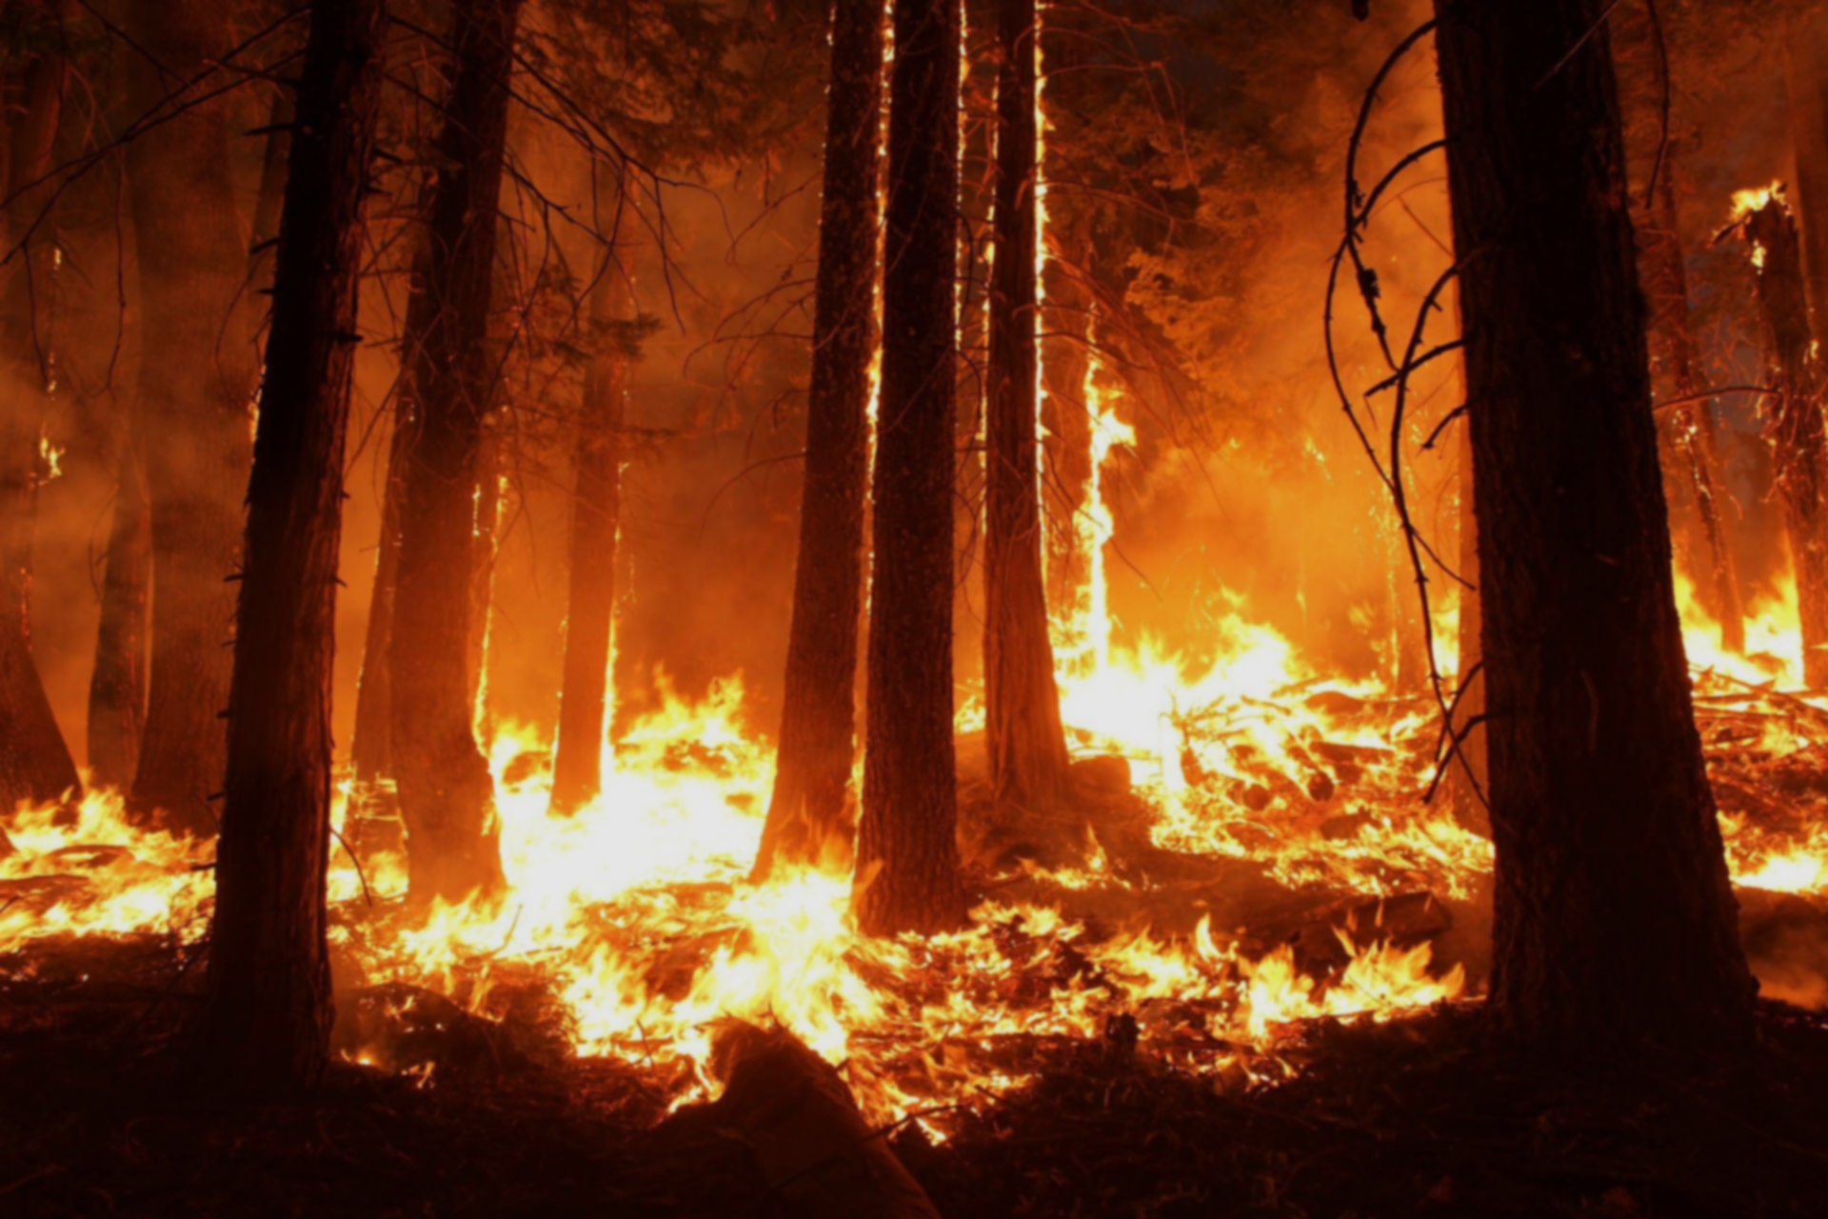
Forest Fire Prediction Analysis
Harsha Vardhan
18-Aug-20

Slide 2
About
Data Description
Use Case: To predict the burned area of the forest in ha
Columns
13
A brief discussion of the feature vectors:
1. X - x-axis spatial coordinate with the Montesinho park map: 1 - 9.
2. Y - y-axis spatial coordinate with the Montesinho park map: 1 - 9.
3. month - month of the year: “Jan" to “Dec"
4. day - day of the week: "mon" to "sun"
5. FFMC - Fine Fuel Moisture Code index from FWI system: 18.7 - 96.20
6. DMC - Duff moisture code index from the FWI system: 1.1 to 291.3
7. DC - Drought code index from the FWI system: 7.9 to 860.6
8. ISI - Initial spread index from the FWI system: 0.0 to 56.10
9. temp - temperature in Celsius degrees: 2.2 to 33.30
10. RH - relative humidity in %: 15.0 to 100
11. wind - wind speed in Km/h: 0.40 to 9.40
12. rain - outside rain in mm/m2: 0.0 to 6.4
13. area - the burned area of the forest in ha: 0.00 to 1090.84
Categorical Features
Rows
517
Month, Day
Nulls
0
Numerical Features
Dependent Variable: Area
X, Y , FFMC , DMC, DC, ISI , Temp , RH , Wind , Rain
Minimum
Maximum
0
1090

Slide 3
About
High Level Data Overview
Use Case: To predict the burned area of the forest in ha
Column Name | Count | Mean | Std Dev | Min | 25% | 50% | 75% | Max
X | 517.0 | 4.669246 | 2.313778 | 1.0 | 3.0 | 4.00 | 7.00 | 9.00
Y | 517.0 | 4.299807 | 1.229900 | 2.0 | 4.0 | 4.00 | 5.00 | 9.00
FFMC | 517.0 | 90.644681 | 5.520111 | 18.7 | 90.2 | 91.60 | 92.90 | 96.20
DMC | 517.0 | 110.872340 | 64.046482 | 1.1 | 68.6 | 108.30 | 142.40 | 291.30
DC | 517.0 | 547.940039 | 248.066192 | 7.9 | 437.7 | 664.20 | 713.90 | 860.60
ISI | 517.0 | 9.021663 | 4.559477 | 0.0 | 6.5 | 8.40 | 10.80 | 56.10
temp | 517.0 | 18.889168 | 5.806625 | 2.2 | 15.5 | 19.30 | 22.80 | 33.30
RH | 517.0 | 44.288201 | 16.317469 | 15.0 | 33.0 | 42.00 | 53.00 | 100.00
wind | 517.0 | 4.017602 | 1.791653 | 0.4 | 2.7 | 4.00 | 4.90 | 9.40
rain | 517.0 | 0.021663 | 0.295959 | 0.0 | 0.0 | 0.00 | 0.00 | 6.40
area | 517.0 | 12.847292 | 63.655818 | 0.0 | 0.0 | 0.52 | 6.57 | 1090.84

Slide 4
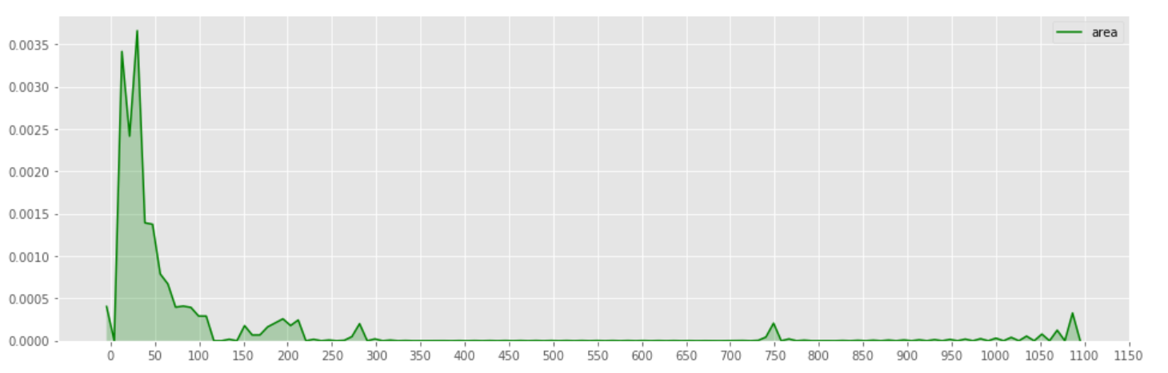
EDA
Dependent Variable Analysis(Area)
95% of the Data points are lying between zero and 200
Only very few data points are greater than 200
The data is highly skewed with a value of +12.84 and huge kurtosis value of 194
It even tells you that majority of the forest fires do not cover a large area, most of the damaged area is under 50 hectares of land.
We can apply transformation to fix the skewness and kurtosis, however we will have to inverse transform before submitting the output.

Slide 5
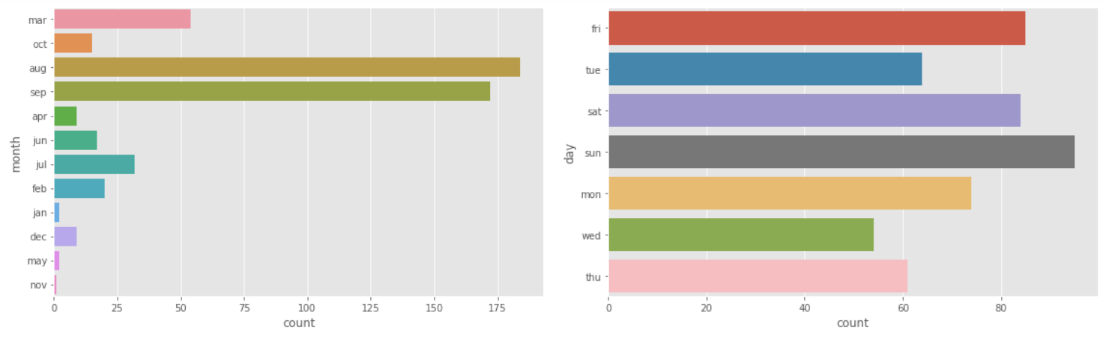
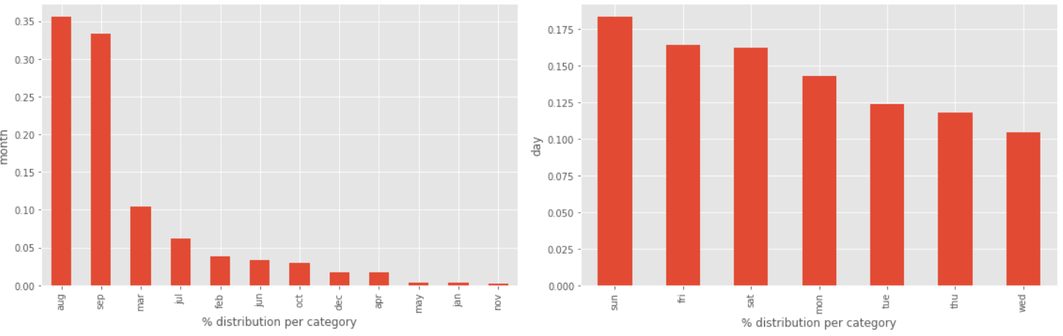
EDA
Analyzing Categorical Variables
Plotted the Month vs number of forest fires occurred to understand the relation between month and burnt area of the forest.
Similarly plotted the day vs burnt area.
It is interesting to see that abnormally high number of the forest fires occur in the month of August and September.
In the case of day, the days Friday to Monday have higher proportion of cases. (However, no strong indicators)

Slide 6
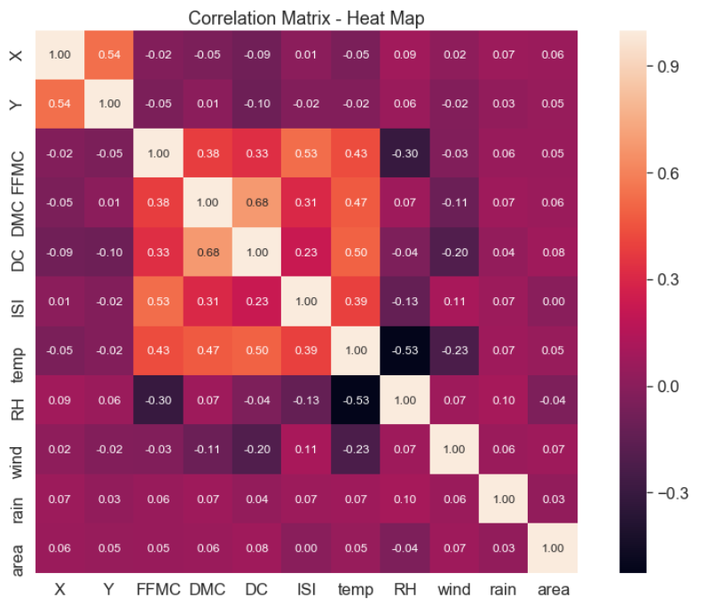
EDA
Relation Between the
Numerical Variables vs Dependent Variable
Plotted the Pearson Coefficient on the numerical variables to understand the relation between numerical and dependent variable Area.
Most of the variables used in the data is not strongly correlated with Area burnt.
But we can see there are lot of multi Collinear variables present in the data
RH, temp , ISI, DC, DMC, FFMC are the strongly multi collinear variables.
X and Y are just locations and hence they are 50% correlated.

Slide 7
Outlier Detection and Data Preparation
Outlier Detection Using Z Score Test
Converting the Dependent Variable into Categories
Column Name | Outlier Values
X | NA
Y | 9 ,9, 9, 9, 9, 8, 9
month | NA
day | NA
FFMC | 63.5, 69. 6,8.2, 63.5 ,53.4, 50.4, 18.7
DMC | NA
DC | NA
ISI | 56.1, 22.7
temp | NA
RH | 97, 99, 96, 94, 100
rain | 1., 6.4, 1.4
area | 212.88, 1090.84, 746.28, 278.53,
wind | 9.4 ,9.4 ,9.4 ,9.4
Area = 0.0 "No damage"
Area <= 1 “Low"
Area <= 25 “Moderate"
Area <= 100 “High"
Area>100 “Very High"
Category | Values
No damage | 247
moderate | 191
high | 41
low | 27
very high | 11
Outliers are present in Y, FFMC , ISI, RH, Rain, Area, Wind columns.

Slide 8
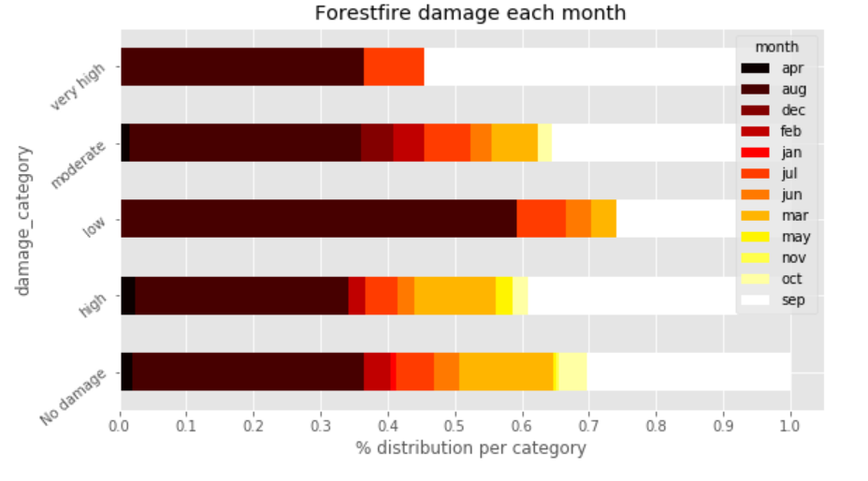
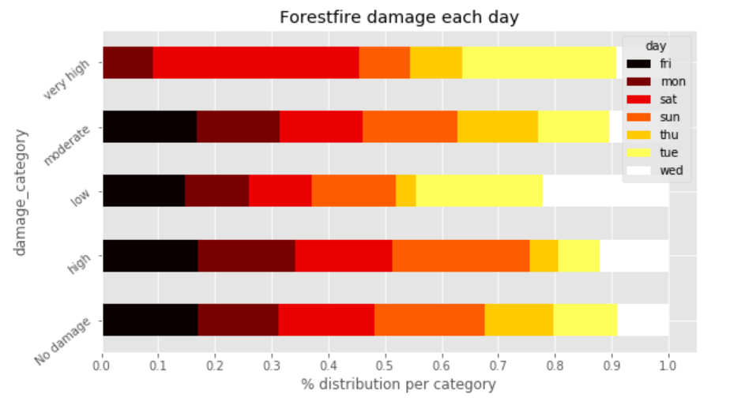
Damage Category VS Month and Day
Analysis on Categories
Previously we had observed that August and September had the greatest number of forest fires. And from the above plot of month, we can understand few things
Most of the fires in August were low (< 1 hectare).
The very high damages(>100 hectares) happened in only 3 months - august, July and September.
Regarding fire damage per day, nothing much can be observed. Except that, there were no very high damaging fires on Friday and on Saturdays it has been reported most.

Slide 9
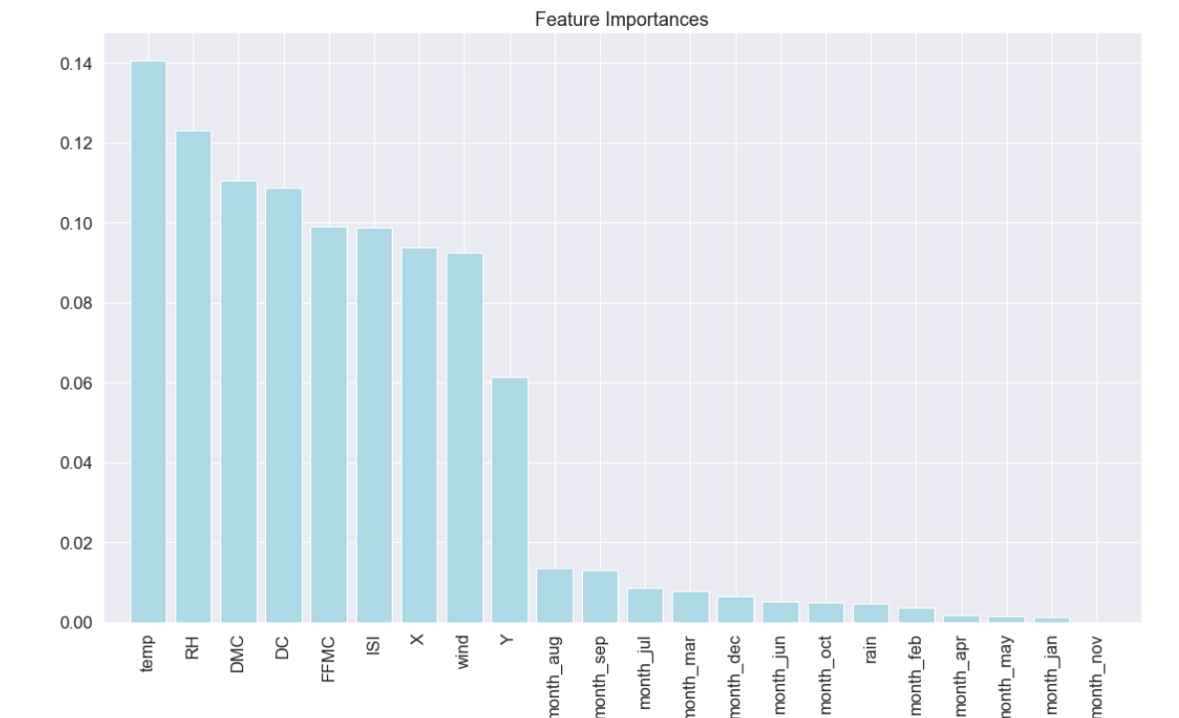
Data Splitting and Model Application
Model Training and Results
Performed the Data Splitting by 75 % to train and 25% to testing.
Converted the month and Day data into One hot encoded variables to use in the modelling.
Applied the Models Like Linear Regression, XGBOOST and SVM on the data and analyzed the overall performance
Linear Regression
XGBOOST Regressor
Support Vector Regressor
MSE--1.28
MSE --1.54
MSE--1.25

Slide 10
Thank you…

